Slide 1
Inclusive Placement Opportunities for Preschoolers: A Systems Approach to Preschool Inclusive Practices
A project of the Virginia Department of Education and the Technical Assistance Centers of Virginia
Notes:
Note to presenter: This module can be changed to reflect the needs of your audience; save the presentation to a location on your computer and make necessary changes.
This module contains activities to promote participant involvement aimed at improving retention of information presented. To learn more about participant-centered training strategies, please refer to: Pike, R. W. (2002). Creative teaching techniques handbook: Tips, tactics, and how-tos for delivering effective training (3rd ed.). Amherst, MA: HRD Press. Or visit the Web site at www.bobpikegroup.com.

Slide 2
Module 1: Planning for Inclusive Practices
Notes:
Today we are going to talk about what is needed to plan for inclusion. It is suggested that before you embark on including young children with disabilities into general education classes, you develop a process for involving key stakeholders from your preschool programs (i.e., ECSE teachers, general education teachers, paraprofessionals, parents, program administrators, and community-based preschool/childcare administrators) who can come together to learn what options will work best in your program/school.
Ask: the participants if they can think of anyone else that is missing who should be included in this discussion.

Slide 3
What does “inclusive” mean to you?
Notes:
Activity: Turn to your partner and share your thoughts on what the term “inclusive” means to you.
Give participants 2-3 minutes to discuss this with each other. At the end of the time, ask participants to share what they discussed.

Slide 4
What do you notice about this picture?
Notes:
Here is one small example of this.
This school photo depicts 7 year old MILES sitting conspicuously apart from the rest of his 22 classmates. As MILES smiles for the camera, he appears to be straining his neck to be closer to the rest of the group.
When his parents saw the photo, they were shocked.
Upon seeing the photo, Miles’ father wrote to the school asking that they retake the picture.
Although MILES’ father found the original photo upsetting and hurtful, he said he did not think the photographer meant to discriminate against his son. "For me, discrimination is a willful exclusion of somebody,” said MILES’ dad. “I don’t believe that’s a case here. ... I think what it is, is just a lack of awareness that resulted in a really emotionally tragic output.”
MILES’ mom, on the other hand, did think the photo was discriminatory. She reported, “I couldn’t comprehend how the photographer could look through the lens and think that this was good composition....This just boggled the mind. Being set aside is horrendous and this was what was happening.”
She went on, "Kids can be cruel but this comes from adults, which is even worse," she stated. "Adults should know better.”
She was right, we should know better but, perhaps like his dad said, it perhaps was simply a lack of understanding how impactful such a photo could be.
So, what can we do to create inclusive, accepting environments? What can we learn from attitude research to make caring inclusive communities a reality ?
(from a Canadian elem. school)

Slide 5
“Oh Mommy! This is so nice!”
http://www.huffingtonpost.com/2013/06/21/miles-ambridge-retake-photo_n_3478937.html
Notes:
Miles’ parents did what we would have done. They never showed Miles the original photograph.
They went to their school administration who happily asked the photographer to come back and re-take the picture. The school was very apologetic and agreed that this was unacceptable.
Upon seeing the new photo, Miles exclaimed “Oh mommy! This is so nice!”
Discussion:
Why is this small act of inclusion so very important? Well, the answer lies in the attitude construct and how our early perceptions lead to either attitudes of acceptance or attitudes of rejection.
One of the first steps in supporting peer relationships is to reflect on our own attitudes about diversity and inclusion and to recognize all the little ways that messages of acceptance are promoted in the class environment.
Then, we turn our focus on identifying what and when to teach social skills that support social interactions and friendships.
http://www.huffingtonpost.com/2013/06/21/miles-ambridge-retake-photo_n_3478937.html

Slide 6
Activity: Is this inclusion?
Notes:
Activity:
Length of time: 10-20 minutes
Use handout: Is this inclusive?
Presenter has the option of breaking participants into small groups or completing with the whole group.
Examples of non-inclusive practices:
Dumping students with disabilities
Grouping by ability level
Cutting back on special education services
Expecting early childhood education staff to teach without support
Identifying children by their disabilities
Separating children with disabilities
Providing pull-out related services
On the other hand, being inclusive does not mean these things.
We must remember that special education is a service, not a place, and that we must provide services to young children with disabilities according to their ISFP or IEP.

Slide 7
What does inclusive really mean?
Notes:
Share with the participants that “inclusive” refers to a value that we hold for our young students. This is a value that involves our commitment to have inclusive communities where families with young children with and without disabilities live and interact daily. They go to the same stores, use the same playgrounds, attend the same community activities, attend the same churches, and GO TO THE SAME SCHOOLS. A value to support “all” means we all assume the responsibility for providing educational opportunities for our young children - not just one program such as early childhood special education. It refers to a commitment to provide specialized instruction when needed that facilitates friendships, fosters self-control, and teaches all children within the context of natural routines.
In order to truly include children with disabilities, teachers, parents, administrators, and related service personnel must collaborate. Not just in name but in reality. It takes individuals working, communicating, and problem solving together to successfully include children with disabilities. Policies that support collaboration have to be in place at the school and division levels. Teachers share responsibility for all children. It is not “mine” and “yours.” All adults in the classroom facilitate friendships and teach within the routine. Again, this takes collaboration.

Slide 8
Is inclusion a good idea?
Notes:
Asking whether inclusion is a good idea is like asking whether Tuesday is a good idea. We’ve all had good Tuesdays and bad Tuesdays. It all depends on what we make of Tuesday or any other day of the week.
Many of the criticisms of inclusion have missed the real meaning of the concept. The principle simply means that when a school division educates a child with a disability, it should do so in a way that least limits or restricts the child’s opportunities to be near and interact with children without disabilities and to have access to the general education curriculum. It does not mean to do away with special services.
Critics of inclusion have been able to point to some bad examples and say, “See, it doesn’t work.” But just as no one would propose doing away with Tuesdays when a bad one occurs, no one should question the value of inclusion because of a bad experience.
Let’s look at other rationales for inclusive practices.

Slide 9
Everyone Is Welcome
Retrieved from https://www.youtube.com/watch?v=1MJrRvpjB1I
Notes:
Everyone is Welcome - https://www.youtube.com/watch?v=1MJrRvpjB1I

Slide 10
Rationale for Inclusive Practices, Part 1
Legal
Moral, ethical, and social
Educational
Notes:
There are also other rationales for inclusion. We will look briefly at each one.

Slide 11
Separateness in Education can…
“Generate a feeling of inferiority as to (children’s) status in the community that may affect their hearts and minds in a way unlikely ever to be undone. This sense of inferiority affects the motivation of a child to learn… (and) has tendency to retard… educational and mental development.”
Chief Justice Earl Warren, Brown vs. Board of Education
Notes:
Read the quote on the slide and have a discussion around the following questions.
Ask: Does anyone know the source of this information?
If someone does provide the correct answer, click to confirm and bring in the Brown vs Board of Education. If no one provides an answer, click to bring in the Brown vs Board of Education.
Since our topic today is inclusion, did anyone think of individuals with disabilities while reading this?
Some in the field of education compare the plight of those with disabilities being excluded to racial segregation.

Slide 12
Activity: Legal Rationale for Inclusion in Early Childhood Programs
Notes:
Activity: Ask participants to work in pairs or groups of three to complete the Rationale for Inclusion in Early Childhood Programs. Give participants 15 minutes to complete the questions in the handout. Once completed, tell participants to self-check as you move through the Power Point slides.
Note to presenter: Print answer key to use when reviewing the information.
Have following documents for participants:
-Dear Colleague Letter
-Virginia Guidelines for Early Childhood Inclusion

Slide 13
LRE for Preschool-Age Children
“The requirements apply to all preschool children with disabilities who are entitled to receive FAPE. Public agencies that provide preschool programs for preschoolers without disabilities must ensure that requirements are met.”
Notes:
The law goes on to include a note related specifically to preschoolers.
Handout: Share the Dear Colleague letter.

Slide 14
LRE in Preschool
“Public agencies that do not operate programs for preschoolers without disabilities are not required to initiate such programs solely for LRE but alternative methods are required such as (age-appropriate settings):
Part-time in (Head Start, VPI, kindergarten)
Placement in private school/preschool
Locating classes at elementary schools
Providing services at the location where the child is presently enrolled”
Notes:
Although public agencies do not need to “create” programs for children with disabilities to be included (for example, if the public agency does not currently have a program that serves 2 or 3 year old children without disabilities), they do not have to start such a program.
But not having such programs does not relieve school divisions of their responsibility to include young children with disabilities with their peers without disabilities. They must seek out various opportunities such as those on the slide.

Slide 15
Indicator 6: Early Childhood Environments
Target A
Children receiving special education services in settings with peers without disabilities
Target B
Children receiving special education services in a separate classroom/building
Notes:
NOTE TO PRESENTER: You will need to access current information from VDOE Web site (www.doe.virginia.gov)
Virginia collects data on the number of hours that young children with disabilities spend being educated and receiving special education services with their peers without disabilities. The expectation is that young children with disabilities spend time with their peers without disabilities.
"Regular education program” means at least 50% of the children enrolled do not have a disability/IEP/IFSP.
Share the Indicator 6 reporting chart from VDOE to participants.

Slide 16
Rationale for Inclusive Practices, Part 2
Legal
Moral, ethical, and social
Educational
Notes:
There are also other rationales for inclusion. We will look briefly at each one.
(This section of the presentation can be used for presentations to the community, school board, etc., if needed.)

Slide 17
Moral, Ethical, and Social Rationale
Notes:
From the United Nations’ Declaration of the Rights of the Child, proclaimed by General Assembly resolution 1386(XIV) of 20 November 1959, Principle 10 states that: “The child shall be protected from practices which may foster racial, religious, and any other form of discrimination. He shall be brought up in a spirit of understanding, tolerance, friendship among peoples, peace, and universal brotherhood, and in full consciousness that his energy and talents should be devoted to the service of his fellow men.”

Slide 18
Challenges
Attitude and belief challenges
Number one identified challenge to preschool inclusion
Policy and procedure challenges
Of the nearly 70 comments related to “policy challenges,” only 19 were likely to actually be policy challenges
Resource challenges
A key finding from research is that inclusive service delivery models do not cost more than separate programs
Notes:
As noted in a national survey on inclusive practices conducted by Barbara Smith and Erin Barton (2014), most respondents thought many challenges were written in policy when in fact they were not.
It’s important to try to access and read a policy that people think exists to determine if the challenge is in fact in policy or just perception or belief. “Don’t believe it ‘til you see it!”
The number one challenge was related to attitudes and beliefs.

Slide 19
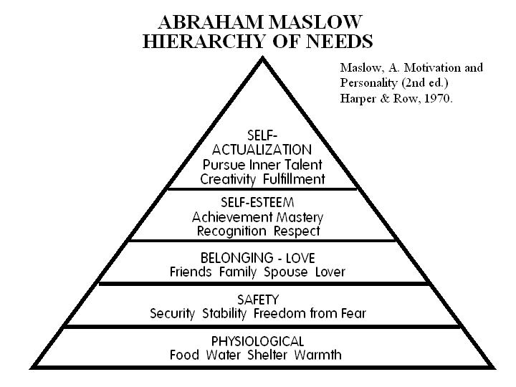
Maslow’s Hierarchy of Needs
Notes:
Another rationale related to preschool inclusion is philosophical in nature.
You may recall Abraham Maslow from your college psychology classes. Maslow is well-known for his hierarchy of needs. He says that all individuals need to meet their basic needs of food and shelter before they are able to acquire security and safety, self-esteem, belonging and love, and ultimately self-actualization.

Slide 20
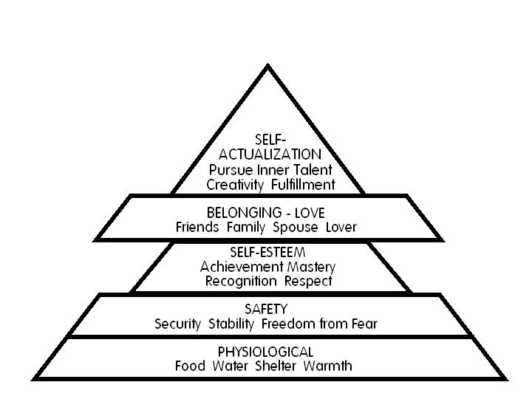
Maslow’s Hierarchy Re-arranged
Notes:
Norman Kunc is a person with a severe disability. Norman was educated in self-contained, segregated classes until he entered high school. At that point he became a self-advocate and began to wonder why he could not be in classes with his friends without disabilities. He pursued such an education and today has published in this area and travels around the world presenting his experiences. Norman says that when we do not include students with disabilities we rearrange Maslow’s hierarchy.
Maslow stressed that only when we are anchored in community, when we belong, do we develop self-esteem. Instead, what happens when children with disabilities are segregated is that they do not have that sense of belonging.
So how do our children develop self-esteem if they do not have the sense of belonging? Too often, developing self-esteem might be related to being toilet trained, doing same work, walking, and using speech and then they “get to belong.” Ironically enough, some of our students with disabilities may NEVER achieve these skills.
To dive deeper, visit this link to read the entire article: https://www.broadreachtraining.com/the-need-to-belong-rediscovering-maslows-hierarchy-of-needs

Slide 21
Inclusive Education: From Political Correctness Towards Social Justice
Notes:
The link below will connect you to one of Norman’s many videos. Please go to https://conversationsthatmatter.org/presenters/kunc-norman to review other videos that you would like to share.
Norman’s video: Inclusive Education: From Political Correctness Towards Social Justice
https://conversationsthatmatter.org/videos/inclusive-education-political-correctness-towards-social-justice

Slide 22
Rationale for Inclusive Practices, Part 3
Legal
Moral, ethical, and social
Educational
Notes:
The last rationale that we will discuss is related to education.
(This section of the presentation can be used for presentations to the community, school board, etc., if needed.)

Slide 23
Educational Rationale
Opportunities for play and social interaction
Role models
Higher expectations
Developmental gains
Notes:
The educational basis for inclusion is the belief that children with disabilities benefit educationally from participation with peers without disabilities. Also children without disabilities benefit from being educated with their peers with disabilities.
There are opportunities for advanced play and interactions that would not necessarily be available in a segregated class.
Children who do not have disabilities can model more advanced language, social, cognitive, and motor skills.
Teachers of students without disabilities may have higher expectations and the classroom activities may be more challenging.

Slide 24
Lea Goes to School
Retrieved from https://www.youtube.com/watch?v=l_QGlbwwCy4
Notes:
https://www.youtube.com/watch?v=l_QGlbwwCy4

Slide 25
Educational Rationale (con’t.)
When included in general education settings, preschool children are more likely to exhibit positive social and emotional behaviors than their peers who are relegated to programs that serve only children with disabilities (Holahan & Costenbader, 2000; Strain, Bovey, Wilson, & Roybal, 2009).
Studies found that high quality inclusive programs support children’s cognitive growth more than settings in which children are not included in a typical early childhood programs (Strain & Bovey, 2011; Holahan & Costenbader, 2000).
Notes:
These are included in the references at the end of the module:

Slide 26
Who Benefits From Inclusive Practices?
Teachers
Children with and without disabilities
Families of children with and without disabilities
Administrators
Notes:
We know that individuals must see how something will benefit them in order to “buy in” to it. Let’s do an activity and see if we can determine the benefits of inclusion.
Activity: Divide participants into groups and have each group identify the benefits for each of these groups. Depending on the number of participants, presenters can do one of the following (or chose another activity):
- Have flip chart paper at each table and have participants make a list for one role.
- Post flip charts around the room. Put the role on the top of each. Have groups of participants rotate around to each chart and list the benefits.
Participants will share benefits in a report out.
After the activity, refer participants to the handout (Benefits chart) in their packet.

Slide 27
Definition of Inclusion in Early Childhood
Including children with disabilities in early childhood programs, together with their peers without disabilities;
Holding high expectations and intentionally promoting participation in all learning and social activities, facilitated by individualized accommodations; and
Using evidenced-based services and support to foster their development, friendship with peers, and sense of belonging.
(Source: USDHHS and USED)
Notes:
The VDOE supports this definition of inclusion that is provided by the US Department of Health and Human Services and the US Department of Education. The above definition applies to all young children with disabilities, from those with the mildest needs to those with the most significant needs. It is the definition that can be found in the Virginia Guidelines for Early Childhood Inclusion (April 2018).
Show the Guidelines booklet and refer participants to where they can locate electronic copy on the VDOE Web site: www.doe.virginia.gov
You hear many terms that mean what is on this slide, but think of the term “inclusive practices” as an umbrella term.
Remember, inclusive practices does not mean the withdrawal of special services or specialized instruction and supports.

Slide 28
Early Childhood Inclusion: A Joint Position Statement of DEC and NAEYC
Retrieved from: http://www.naeyc.org/files/naeyc/file/positions/DEC_NAEYC_EC_updatedKS.pdf
Notes:
28
Share Joint Position Statement handout with participants.
Explain NAEYC and DEC position statement. The Division for Early Childhood of the Council for Exceptional Children has a position paper on inclusion that states the Council supports the right of all children to participate in natural settings in their communities. NAEYC has endorsed the position paper as well.
http://www.naeyc.org/files/naeyc/file/positions/DEC_NAEYC_EC_updatedKS.pdf
28

Slide 29
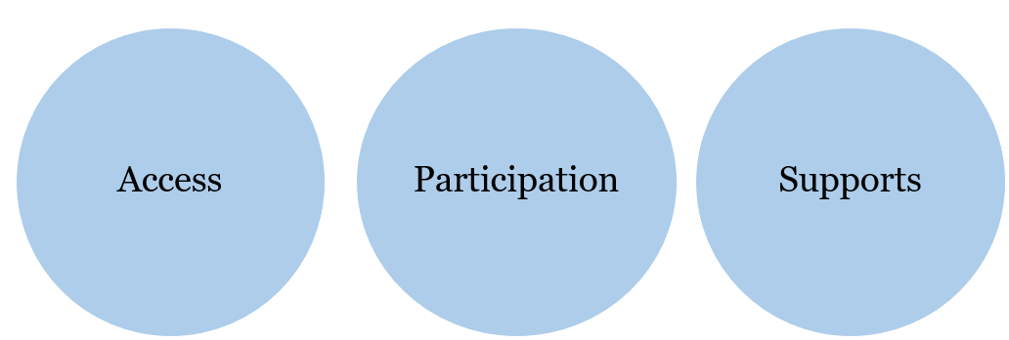
Three Defining Features of Inclusion, Slide 1
Notes:
The Joint Position Statement refers to these defining features of inclusion. Let’s take a look at each.

Slide 30
Defining Features of Inclusion, Slide 1
Access – providing a wide range of activities and environments for every child by removing physical barriers and offering multiple ways to promote learning and development
Notes:
Before showing definition, ask the group: “What does ‘Access’ mean to you? How would you define access?”
After hearing from participants, show the definition on the slide and then ask participants to share some examples of what access would look like in a classroom (children being able to reach all materials, large enough pathways in the classroom to allow for wheelchairs or walkers, etc.).
Share examples of access to the curriculum – share information related to Universal Design for Learning (UDL).

Slide 31
Defining Features of Inclusion, Slide 2
Participation – using a range of instructional approaches to promote engagement in play and learning activities and a sense of belonging for every child
Notes:
Before showing definition, ask the group: “What does ‘Participation’ mean to you? How would you define participation in the context of inclusion? “

Slide 32
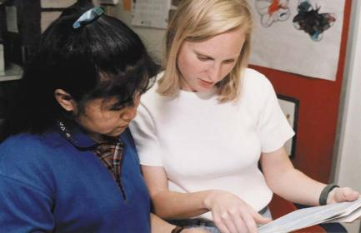
Defining Features of Inclusion, Slide 3
Supports – broader aspects of the system such as professional development, incentives for inclusion, and opportunities for communication and collaboration among families and professionals to assure high quality inclusion
Notes:
The last defining feature of inclusion is supports.
Ask participants to share what they consider supports.
Then show the above definition.

Slide 33
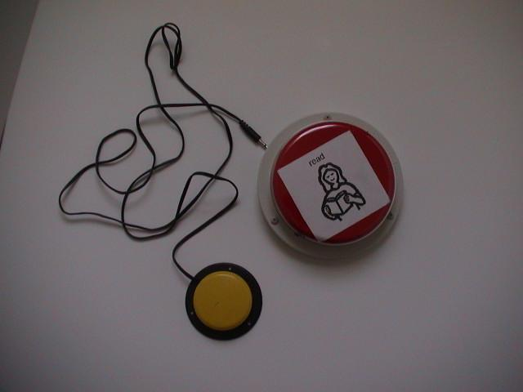
Assistive Technology
Notes:
Assistive technology (AT) interventions involve a range of strategies to promote a child’s access to learning opportunities, from making simple changes to the environment and materials to helping a child use special equipment. Combining AT with effective teaching promotes the child’s participation in learning and relating to others.
Another means of gaining access to the environment and learning can be achieved through the use of AT.
Ask participants to turn to their neighbors and share examples of AT they use (eyeglasses, daily planners, highlighters, etc.).
Share other examples of AT that children might use (visual schedules, built up grips, switches, communication devices [i.e., Big Macs], communication boards, etc.).

Slide 34
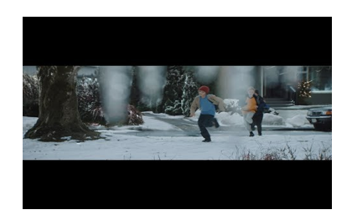
We All Win
Retrieved from https://www.youtube.com/watch?v=v70Fu2WU8-w
Notes:
Hyperlink in slide to this video https://www.youtube.com/watch?v=v70Fu2WU8-w

Slide 35
Do you want good health?
Notes:
How do we go about making the changes that are needed that lead to successful inclusion? Let’s first think about what goes into making changes in general and how these changes might begin with our basic beliefs. Let’s think about what we all might know about good health.
Activity: If you want good health, stand up. Now, if you know that smoking is bad for your health and you do not smoke, remain standing. If you do smoke, please sit down.
If you want good health and you know that regular exercise is important to good health and you exercise 3 to 5 times a week for at least 30 minutes, remain standing. If you do not, please sit down.
If you want good health and you know that a balanced diet, which meets the recommended requirements for servings of whole grains, vegetables, fruits, etc., a day, is important and you eat that way every day, remain standing. If you do not, sit down.
If you want good health and you know that regular physical checkups are important for preventing problems and you follow your doctor’s recommended schedule, then remain standing. If you don’t then sit down.
This activity illustrates that we all know what we want and we have the knowledge required but we don’t always do what is necessary to achieve what we want. Past experiences influence beliefs. If you have a 95-year-old grandmother who never exercised a day in her life, you may not believe that exercise is necessary for good health.
This activity also demonstrates the power of beliefs in individuals and organizations. Right now you have a vision: inclusion of children with disabilities in regular preschool programs. But inclusion cannot simply happen by providing training. We have to agree on some basic beliefs.

Slide 36
What are our common beliefs?
All children can...
Notes:
All children can learn.
All children deserve the opportunity to be educated with other children their age in communities.
All children can participate in inclusive preschools if they are given the appropriate support.
Some of the basic beliefs that professionals who are working toward inclusive practices hold probably include some of the ones on the slide.
If professionals are considering inclusive programming and do not hold these beliefs, it might be worthwhile for members of the team to explore their feelings about inclusion before they get started. We also have to have basic beliefs regarding our roles.
We are all good teachers, therapists, and administrators and we can be better if we change to use best practices and we all work toward a common purpose or vision.
For each child to receive a quality inclusive education, we will need to make an individual as well as a group commitment to work together as a team. We are experts in our field but none of us is an expert in inclusive practices.

Slide 37
Change Happens When You..
Believe that change will benefit you and others and see the outcomes as positive
Share your perceptions, beliefs, needs, and wants and have them understood and respected
Realize that change is accompanied by risk, fear, and possible failure, and are willing to take risks
Notes:
In order to begin including children and to achieve excellence in educational programming, change is required. For example, the change to an inclusive preschool may mean the early childhood special education teacher takes the risk of giving up control of her “own” classroom. The early childhood teacher may fear that she will be unable to meet the needs of a child with disabilities in the classroom.
Keep in mind two other important beliefs:
First, that there is no such thing as failure, only feedback and results. Risk is necessary to grow and develop.
Second, we are free to make mistakes. Our success depends to a large degree on how well we process the feedback we get regarding our efforts (Alessi, 1991).

Slide 38
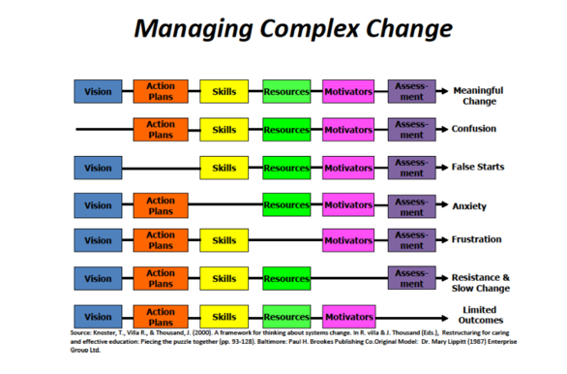
Components of Change
(Adapted from Knoster, T., & Villa R., & Thousand, J., 2000)
Notes:
When any change is occurring there are certain components that need to be in place in order for meaningful, sustaining change to occur.
If any of the components is missing it can contribute to certain feelings.
This chart can help you to see what might be contributing to what is occurring.

Slide 39
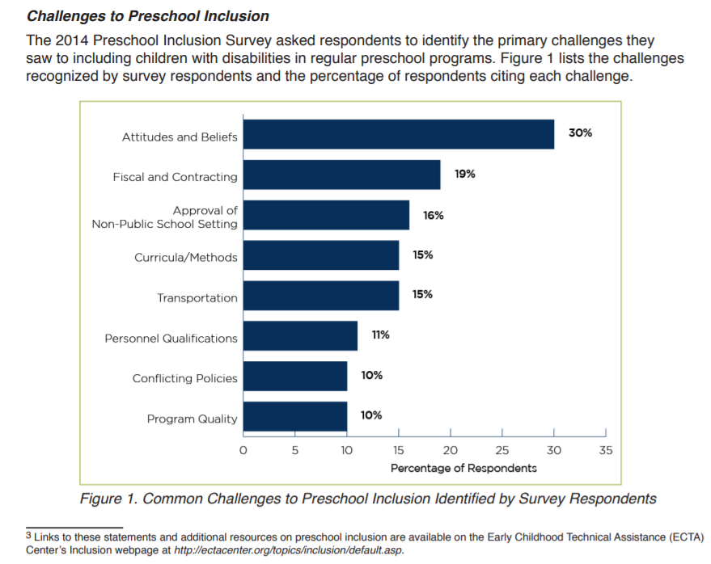
2014 Preschool Inclusion Survey
Retrieved from https://elc.grads360.org/services/PDCService.svc/
GetPDCDocumentFile?fileId=9652
Notes:
Go to the link below to find out details about the survey that is represented in this slide.
https://elc.grads360.org/services/PDCService.svc/GetPDCDocumentFile?fileId=9652
Provide details as determined necessary to inform participants about the survey findings and solutions to increase preschool inclusion.

Slide 40
Activity: Identifying the Barriers to Inclusion
Identify concerns you have about implementing preschool inclusion
Describe barriers which exist to providing a quality inclusive preschool program
Record the responses on the handout
Notes:
Activity: The purpose of this activity is to have teams/individuals who are receiving this information to think about and identify barriers to their specific school’s programs or division.
Have participants use the “Bucket” handout and identify concerns.
Depending on who you have as the participants (teams from different schools, programs, or individuals from one school, program), determine how to organize this activity (teams or individuals complete). Presenter should collect copies of the handout or provide this to someone who is leading this effort within the school, program

Slide 41
Reframing Change
Used with permission from Kristie Pretti-Frontczak, B2K Solutions, Ltd.
Notes:
Activity: Once barriers and concerns have been identified, have participants use the handout:. What We Can Control.
Have them determine what column the concerns and barriers fit in.

Slide 42
Next Steps to Planning for Quality
Benchmarks of Quality in Inclusive Practices
Notes:
Now that you all have identified barriers/concerns, let’s look at how to build a system that will support inclusive practices that will sustain.
Introduce the Benchmarks of Quality (BOQs) related to inclusive practices (see BOQs in handout section).
Review, and if presenter decides to have the team complete the BOQs, then you will need to factor in additional time for this. If just introducing, then the team would complete the BOQs in a follow up team meeting.
Note to presenter about multiple BOQs.

Slide 43
Activity: Mapping
Think about your program as it is now: the knowledge, skills, resources, attitudes and relationships available related to inclusive practices.
Draw where you would like to be in these areas as you plan to expand or enhance your current program.
Notes:
Activity: Refer to the handout Individual Mapping and devote time to having participants follow the directions.
Materials needed: blank paper and markers.

Slide 44
Contexts for Inclusive Opportunities
Public School Programs
Virginia Preschool Initiative (VPI)
Preschool funded by Title 1
Preschool funded by local funds
Head Start operated by the public school
Occupational child care programs
(Virginia Guidelines for Early Childhood Inclusion, Figure 1, p.13)
Community-Based Entities
Private for-profit preschool
Private not-for-profit preschool
Child care
Community-based play groups
Department of Defense Child Development Programs
Head Start
Head Start/Early Head Start operated by a community agency
Notes:
Review the various contexts that can be used to include children with disabilities.
Note when reviewing these contexts that the resources available in public schools and localities may vary.
See Virginia’s Guidelines for more information you might want to share with participants.

Slide 45
Inclusive Options
Individual Teacher Model
Co-Teaching Model
Itinerant Model
Reverse inclusion
(Virginia Guidelines for Early Childhood Inclusion)
Notes:
Refer to the Virginia Guidelines for Early Childhood Inclusion found on the VDOE Web site.

Slide 46
Individual Teacher Model
Classroom of children with and without IEPs
Teacher is licensed and dually endorsed in ECSE and Pre-K
(Virginia Guidelines for Early Childhood Inclusion)
Notes:
In this model the teacher is skilled in meeting the needs of both groups of children, with and without IEPs. Teacher is licensed and dually endorsed in ECSE or either ECE for 3 and 4 year olds with an add-on endorsement (early/primary education PreK -3, or elementary education PreK -6). All 3 endorsements collectively are referred to as PreK-K endorsed.
Careful consideration is given to the caseloads and mix of children with and without disabilities.
This Includes the level of support required.

Slide 47
Co-Teaching Model of Collaboration
Pre-K teacher and ECSE teacher share responsibility and combine expertise to meet the needs of all children in the classroom
ECSE teacher may be in the classroom for all or some of the school day
(Virginia Guidelines for Early Childhood Inclusion)
Notes:
This is another way to achieve full inclusion using a collaborative model.
In this model, the Pre-K and ECSE teachers share responsibility and their expertise to meet the needs of all children in the classroom. ECSE teacher may be in the class all or some of the day. Goal is for both teachers to share equally in the instruction of the education including the implementation of the children's IEPs.
Activity: Turn to your neighbor and share other ways you could set up a collaborative model.

Slide 48
Essentials of a Co-Teaching Model
Roles and Responsibilities are established around:
Planning for and delivery of instruction
Social and emotional supports
Assessment, including program monitoring
(Virginia Guidelines for Early Childhood Inclusion)
Notes:
There are certain “essentials” that are necessary to ensure that a co-teaching model is successful.
Co-teachers must look at the above areas and determine how each will participate in the planning, instruction, assessment, and progress monitoring of all children.
See roles and responsibilities in handouts of this module.

Slide 49
Itinerant Model of Collaboration
ECSE teacher travels between classrooms or programs to consult with PreK teacher and/or provide direct instruction to individual children as needed
(Virginia Guidelines for Early Childhood Inclusion)
Notes:
Another way to provide support to children with an IEP who are enrolled in a general education classroom is using an itinerant model of collaboration.
In this model, the ECSE teacher may serve a caseload of up of up to 12 children with IEPs according to Virginia regulations.
ECSE teacher travels to a variety of classes or programs to consult with Pre-K endorsed teachers and to provide direct services to individual children as needed.
A good resource is A Guide to Early Childhood Itinerant Services. SOURCE?

Slide 50
Essentials of an Itinerant Model
The ECSE and ECE teachers meet to plan and discuss children’s individual educational needs
(Virginia Guidelines for Early Childhood Inclusion, VDOE)
Notes:
An itinerant model of support would also require staff to plan together and determine what the child needs.
Depending on what the child’s IEP indicates, this could mean direct services to the child, consultation with the ECE teacher, or both.

Slide 51
Reverse Inclusion
ECSE classroom operated by school division ECSE personnel
Children without disabilities are recruited to attend the preschool program
(Virginia Guidelines for Early Childhood Inclusion)
Notes:
Share that is model is used when there are no general education preschool programs such as the Virginia Preschool Initiative (VPI), Head Start (HS), or a community preschool/childcare program available.
An ECSE classroom enrolls same-age peers without disabilities. To quality as a regular education class, at least 50% of the children should qualify as typically developing.
Note: Classroom is lead by an ECSE teacher and modifications will need to be made to the classroom and curriculum to address learning of children with varying abilities. Providing only a few children without disabilities does not provide for the intent of reverse inclusion.

Slide 52
Essential Components of Reverse Inclusion
To qualify as an ECE classroom, at least 50% of the children are typically developing
Regular attendance by children without disabilities
An evidence-based curriculum is used
(Virginia Guidelines for Early Childhood Inclusion)
Notes:
For the reverse model to be considered a “general education class,” there should be at least 50% of the children without disabilities. Also, over 50% will ensure there are enough children without disabilities to have appropriate role models.
Curriculum: suggested use of a quality curriculum that is being used in regular Pre-K classes.
Also, use of a curriculum-based assessment is recommended.

Slide 53
Finding the Right Fit
Notes:
Presenter has the option of structuring this activity in several ways depending on the participants. If you have individual participants from various programs/schools/divisions, then you could structure the activity to do the matrix individually around 1 child. If participants are from one program/school/division, they could complete as a team.
Before talking about Pros and Cons, introduce participants to the Level of Support Matrix. Review the directions and complete the tool around 1 or more children. See handouts in this module.
Activity: Post flip chart paper on the wall with the inclusive options listed and a heading for pros and cons.
Assign groups to the various options and tell them to list the pros and cons of each of the options.
Refer to Appendix N and O for the directions for using the Levels.

Slide 54
Why Do Program Evaluation?
To document what we did so that we can repeat success and avoid failures
To find out whether we are making progress toward reaching the outcomes that we have targeted
Notes:
The team should also determine how it is going to evaluate efforts in order to continue to do what works and avoid what doesn’t work.
Evaluation should be one of the first items that the team thinks about.
An evaluation plan should be written and included in the action plan.

Slide 55
Evaluate To Sustain
What happened?
What changed?
How much?
How do you know?
So what?
What’s next?
Notes:
These questions can help guide the team in developing the action plan.
Refer back to the BOQs - critical elements of making data informed decisions, and evaluate implementation activities.

Slide 56
References
Barton, E.E., & Smith, B.J. (2015). The preschool inclusion toolbox: How to build and lead a high-quality program. Baltimore, MD: Paul H. Brookes.
DEC/NAEYC. (2009). Early childhood inclusion: A joint position statement of the Division for Early Childhood (DEC) and the National Association for the Education of Young Children (NAEYC). Chapel Hill: The University of North Carolina, FPG Child Development Institute.
Grisham-Brown, J., & Hemmeter, M.L. (2017). Blended practices for teaching young children in inclusive settings (2nd ed.). Baltimore, MD: Paul H. Brookes.
Gupta, S., Henninger, IV, W.R., & Vinh, M.E. (2014). First steps to preschool inclusion: How to jumpstart your programwide plan. Baltimore, MD: Paul H. Brookes.
Notes:
ECTA document with survey results

Slide 57
References, Slide 2
Holahan, A., & Costenbader, V. (2000). A comparison of developmental gains for preschool children with disabilities in inclusive and self-contained classrooms. Topics in Early Childhood Special Education, 20, 224-235.
Knoster, T., Villa R., & Thousand, J. (2000). A framework for thinking about systems change. In R. Villa & J. Thousand (Eds.). Restructuring for caring and effective education: Piecing the puzzle together (pp. 93-128). Baltimore, MD: Paul H. Brookes.
Pretti-Frontczak, K., Grisham-Brown, J., & Sullivan, L. (Eds.). (2014). Blending practices for all children. (Young Exceptional Children Monograph Series No. 16). Los Angeles, CA: Division for Early Childhood of the Council for Exceptional Children.
Strain, P.S., Bovey, E.H., Wilson, K., & Roybal, R. (2009). LEAP preschool: Lessons learned over 28 years of inclusive services for young children with autism. Young Exceptional Children Monograph Series No. 11, 49-68.

Slide 58
References, Slide 3
Strain, P.S., & Bovey, E.H. (2011). Randomized, controlled trial of the LEAP model of early intervention for young children with Autism Spectrum Disorders. Topics in Early Childhood Special Education, 31, 133-154.
US Department of Education, Office of Special Education and Rehabilitative Services. (201, January 9). Dear Colleague Letter on Least Restrictive Environments in Preschool. Available at https://www2.ed.gov/policy/speced/guid/idea/memosdcltrs/preschool-lre-dcl-1-10-17.pdf
Virginia Department of Education. (2018). Virginia guidelines for early childhood inclusion. Richmond, VA: Author.
Webinar Summary Early childhood inclusion: Challenges and strategies from the 2014 preschool inclusion survey. (n.d.). Retrieved from https://elc.grads360.org/services/PDCService.svc/GetPDCDocumentFile?fileId=9652

Slide 59
Thank You!
If you have any questions about the content in this module or need further assistance implementing a systems approach to early childhood inclusive practices, please contact the early childhood staff at the following T/TACs.
Regions 1 & 8 VCU 804-828-6947 or 434-292-3723
Regions 2 & 3 ODU 757-683-4333
Region 4 GMU 703-993-4496
Region 5 JMU 540-568-6746
Regions 6 & 7 VT 540-231-5167

